Slide 1
Africa

Slide 2
Outline
Overview
Geography, governments, economy
Colonialism
Civil Conflict
Congo/Rwanda
Sudan
Mali

Slide 3
What is the first word that comes to mind to describe Africa?

Slide 4
African Diversity
Africa is a diverse place
Geography
Democracy
Economy

Slide 5
Geography

Slide 6
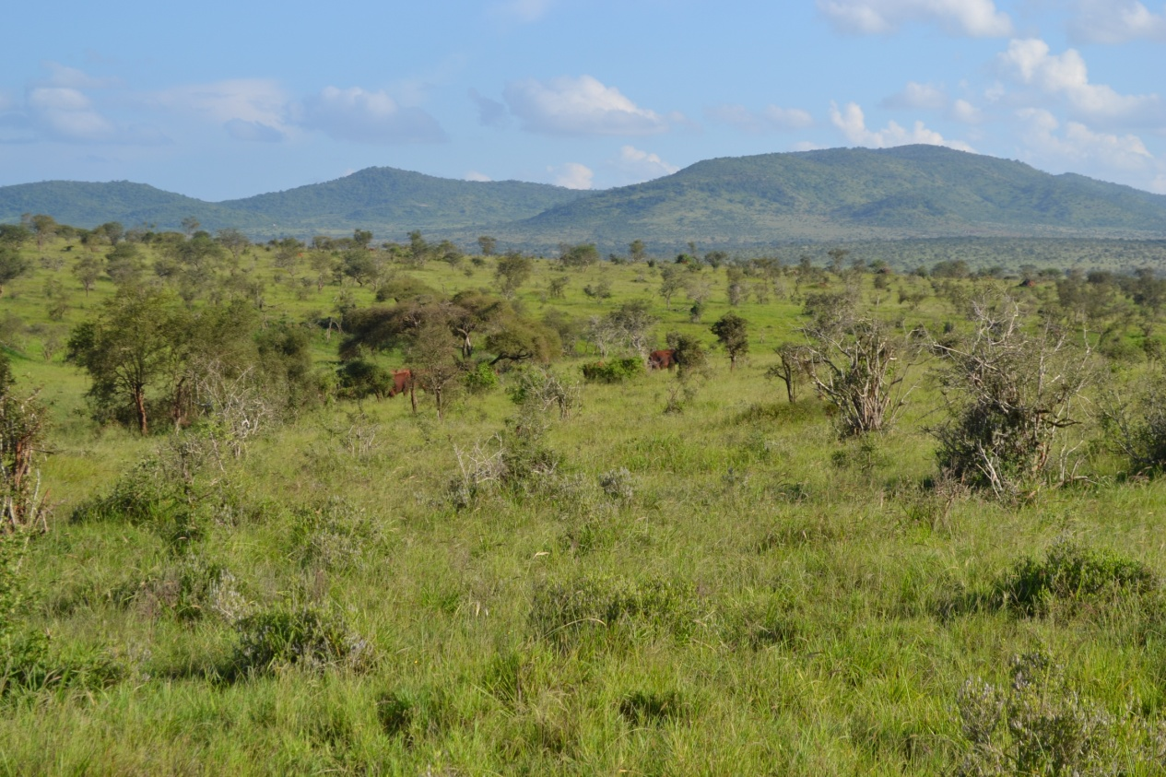
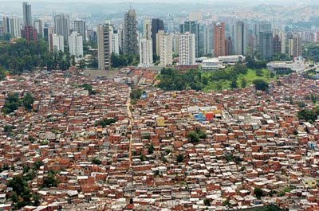
Geography

Slide 7
Democracy

Slide 8
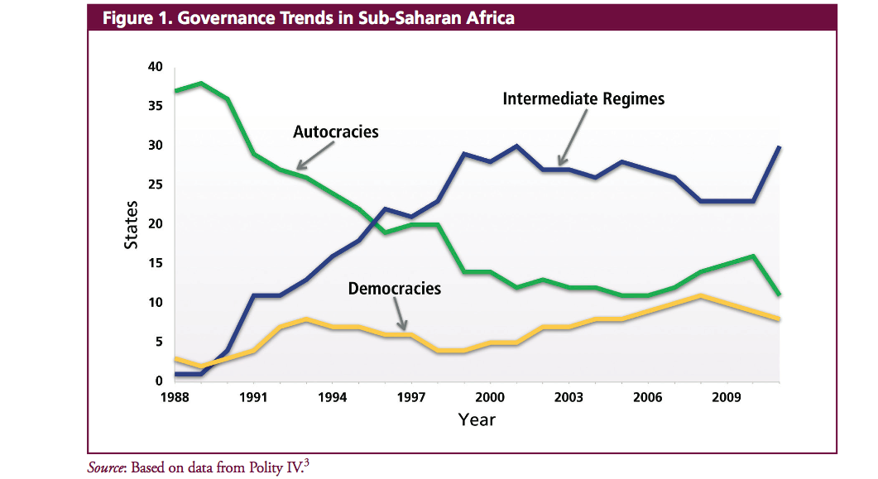
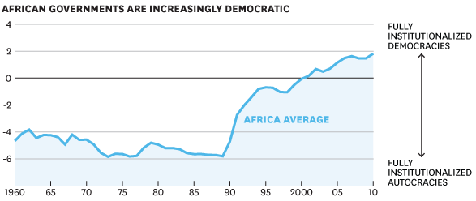
Democracy

Slide 9
Economy - GDP

Slide 10
Economy - growth

Slide 11
Human Development Index

Slide 12
Human Development Index

Slide 13
Scramble for Africa (1913)

Slide 14
Decolonization

Slide 15
Civil Conflict
Identity and ethnicity
Resource curse
Spillover

Slide 16
Identity

Slide 17
Identity
Most scholars now regard ethnicity as socially constructed and not inherent
Partly constructed by creating “other” or out-group
Still a potent motivation for action and conflict

Slide 18
Resource Curse
To start a rebellion “all you needed was $10,000 and a satellite phone” – Laurent Kabilla
Resources prevent development of state institutions
Resources provide motivation for conflict
Resources provide the means for conflict
Example: conflict diamonds

Slide 19
Spillover
Conflicts often affect countries around them
Refugees
External support
Combatants move to neighboring states

Slide 20
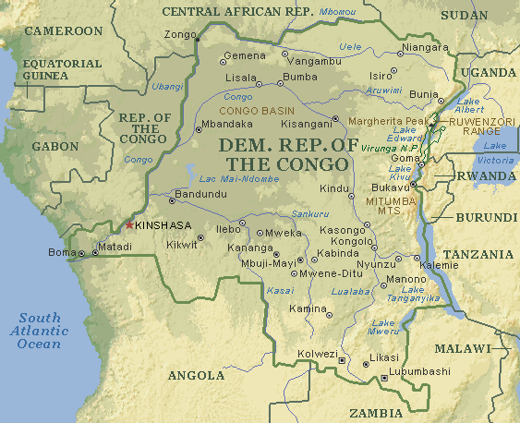
Congo/Rwanda
Congo colonized by Belgium
Ruled brutally
Rwanda initially ruled by Germany
Taken over by Belgium after World War I

Slide 21
Congo Crisis - 1960
Little planning for independence
Immediate political crises
Provinces of Katanga and South Kasai attempted to secede
Rebellion suppressed with the help of the UN
Joseph Mobutu seized power in 1965 – imposed partial stability

Slide 22
Rwanda
Hutu/Tutsi division solidified by Belgians
Tutsis favored by Belgians, Hutus took over after independence
Cycles of violence began

Slide 23
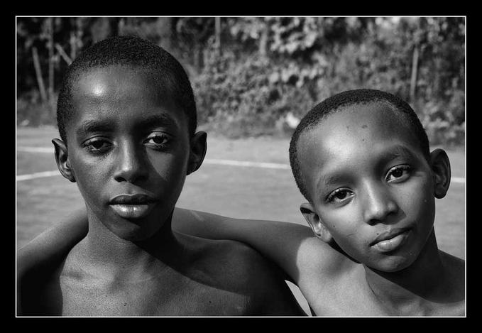
Tutsi and Hutus

Slide 24
Rwandan Civil War and Genocide
Tutsi Rwandan Patriotic Front invaded in 1990
Arusha accords 1993 temporarily ended Civil War
Juvenal Habyarimana shot down April 6, 1994
Sparked Hutu genocide of Tutsis
Between 500,000 and 1,000,000 killed
RPF re-launched offensive and conquered Rwanda

Slide 25
First Congo War (1996-97)
Many Hutus fled to Congo after RPF conquered Rwanda
In 1996, Rwanda began supporting rebels in Zaire/Congo to pursue Genocidaires
Led by Laurent Kabila, the rebels marched on Kinshasa and overthrew Mobuto in 1997

Slide 26
Second Congo War (1998-2003)
Kabila was unable to stabilize the country. Fell out with Rwandan supporters
Alarmed ethnic groups in Eastern Congo, which revolted
Began new civil war
External support on one side or the other by numerous countries
Including Rwanda, Uganda, Angola, Zimbabwe
Between one and five million people excess deaths due to conflict

Slide 27
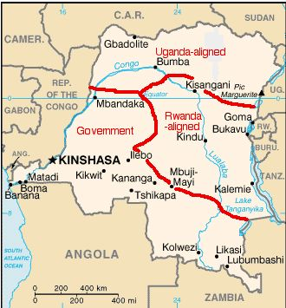

Slide 28
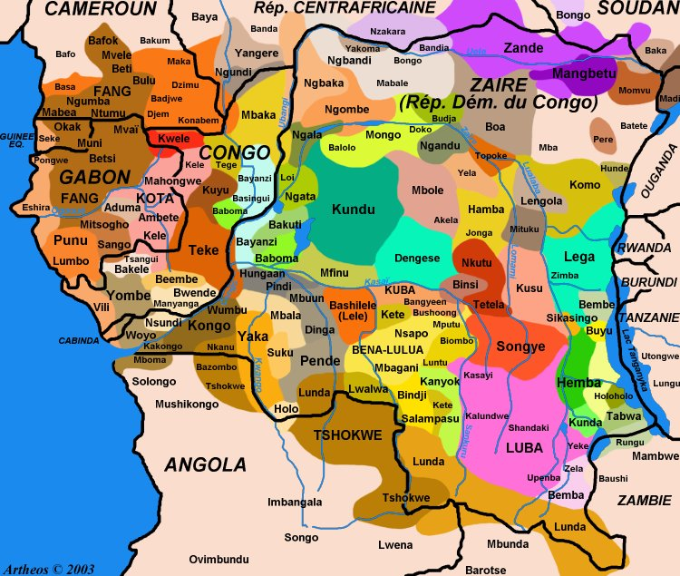
Congo ethnic groups

Slide 29
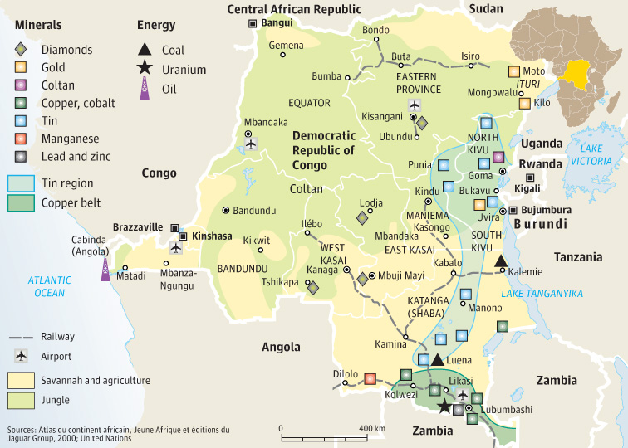
Congo Resources

Slide 30
Congo
Transitional government formed in 2003, elections held in 2006
Remains violent – recently M23 rebels took Goma

Slide 31
Sudan
Largely Muslim in North, Christian in South
Conquered by British after the Mahdi revolt in late 1800s
Had tried to unify Sudan through radical Islam
Ruled as a joint British-Egyptian protectorate – virtually a colony
Became independent in 1956

Slide 32
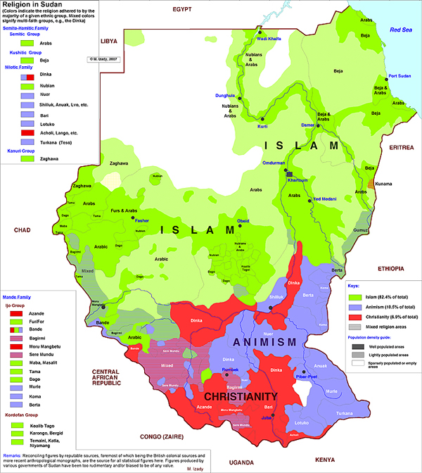
Sudan – 1st Civil War
South rebelled in 1955
Southern groups unite in 1969
Peace agreement made in 1972 – granted autonomy

Slide 33
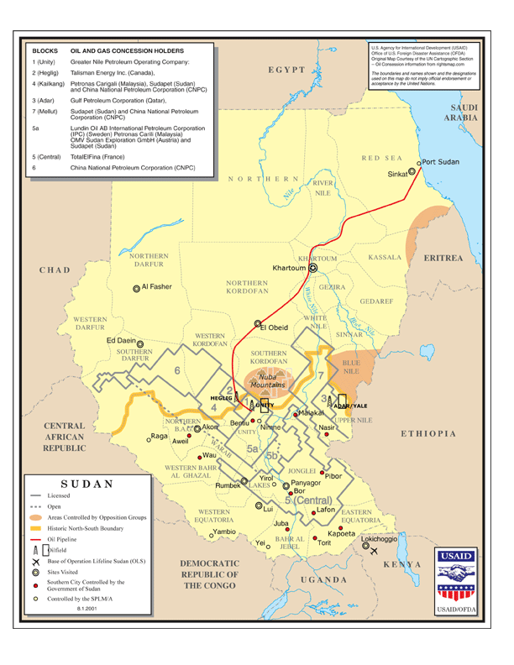
Sudan – 2nd Civil War
1978 oil discovered – autonomy revoked
1983 – Sharia law imposed – prompted revolt by South Sudan
SPLA formed
1-2 million people died

Slide 34
Peace Agreement
Peace agreement signed in 2005
South regained autonomy
South would have referendum on independence in 2011 – voted to secede
Territory of Abyei disputed

Slide 35
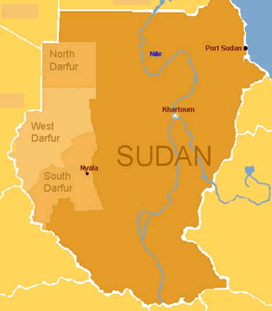
Sudan - Darfur
During peace process, some people in Darfur felt left out
In 2003 began revolt against government.
Creates conflict between “Africans” and “Arabs”
Sudanese government supports Janjaweed militia

Slide 36
Chad
Darfur conflict connected to Civil War in Chad
Chad supported Darfur rebels
Sudan supported rebels in Chad

Slide 37
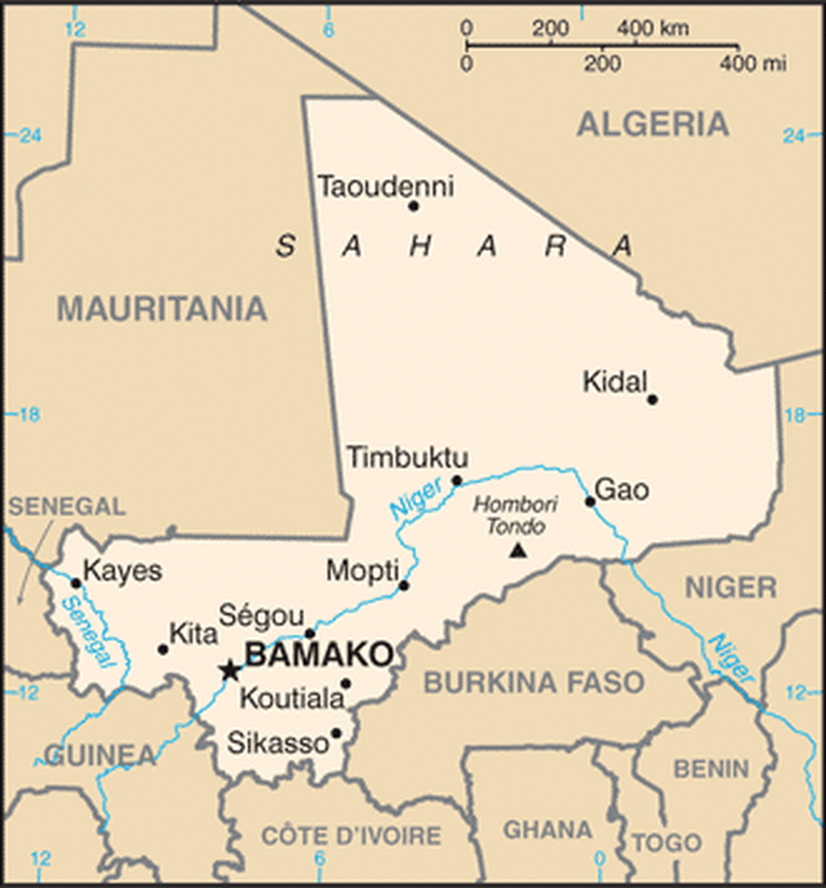
Mali
Colonized by the French in the late 1800s
Granted independence in 1960
Initially ruled by dictators until 1991
Moussa Traore overthrown following protests in 1991
Relatively stable democracy established

Slide 38
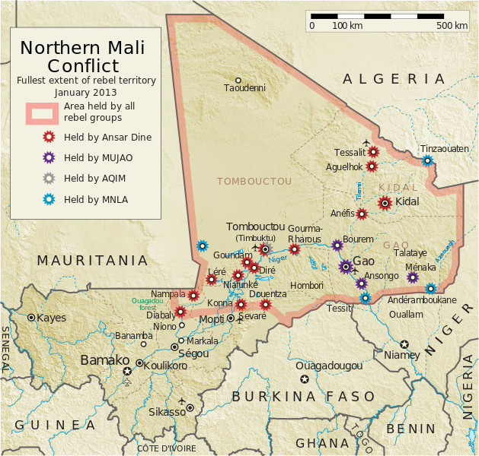
Mali
Nomadic Tuareg ethnic group has traditionally felt marginalized by the Malian government
Had previously staged rebellions in 1990-95 and 2007-09
Influx of Tuareg fighters from Libya followed Libyan revolution – sparked new uprising
Multiple rebel groups – MNLA, AQIM, Ansar Dine

Slide 39
Mali
MNLA and Islamist groups fighting each other as well as government
French military intervened in January, 2013
Retook most major cities
MNLA negotiating with government
Islamists fled into the desert

Slide 40
External Intervention
Peacekeeping forces deployed in Rwanda and Congo (UNAMIR, MONUC)
Diplomatic pressure and sanctions on Sudan
Also peacekeeping forces (UNMIS, UNAMID)
French intervention in Mali

