Slide 1
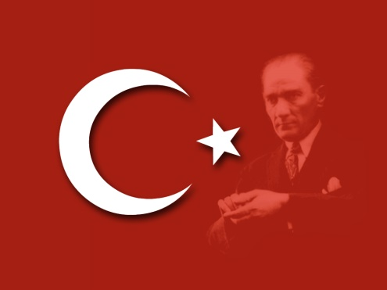
Darbe Türkiye’de (The Coup in Turkey) July 15 2016

Slide 2
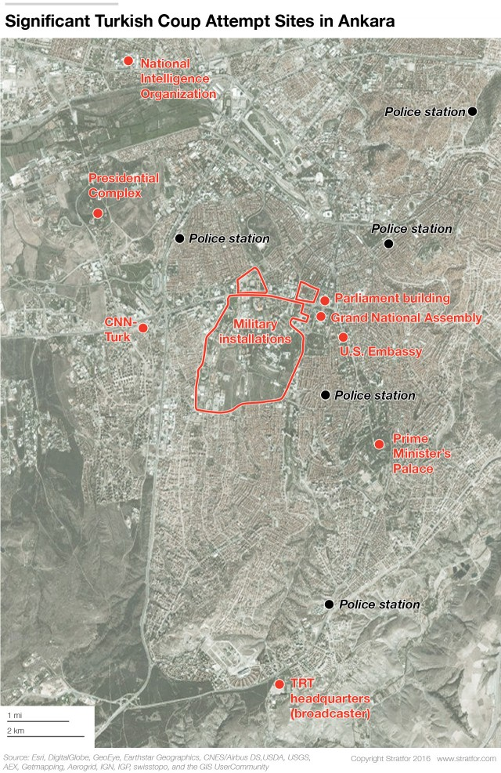
Darbe Türkiye’de
The attempted coup used tanks, attack helicopters and fighter jets leaving 161 dead & 1440 wounded
Began by closing 2 Key Bosphorus bridges
Attacks were made on the Meclis (parliament) and several TV stations
Erdoğan escaped capture in Marmaris & called for the people to go in to the streets on Instagram. The call was echo’d in the Mosques

Slide 3
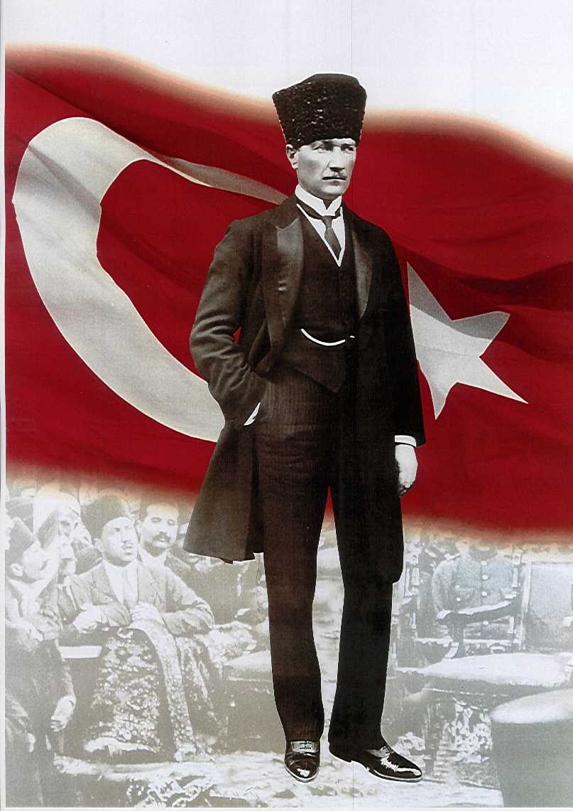
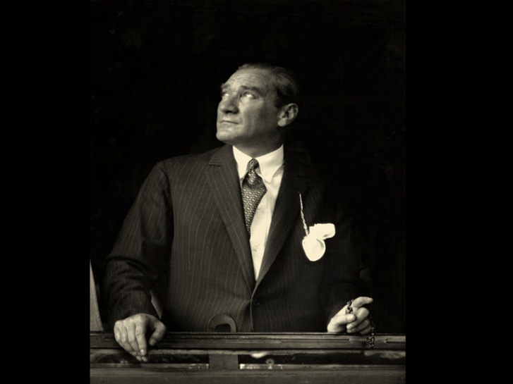
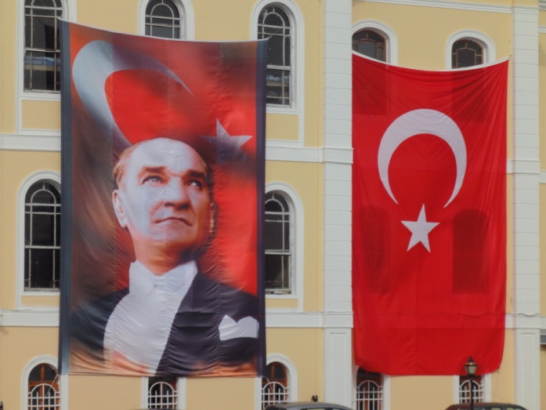
The Legacy of Mustafa Kemal “Attaturk”
The secular Turkish Republic and the military as the defender of that principal

Slide 4
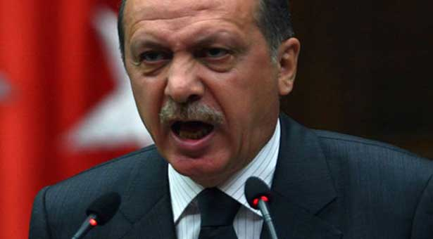
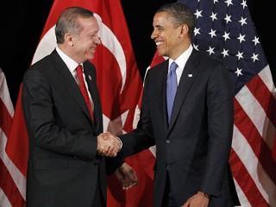
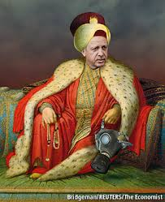
Recep Tayyip Erdoğan
Is the Problem Islam or Erdogan?
Sultan Tayyip

Slide 5
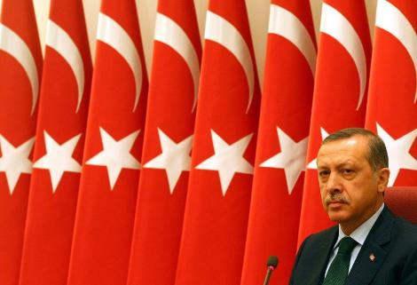
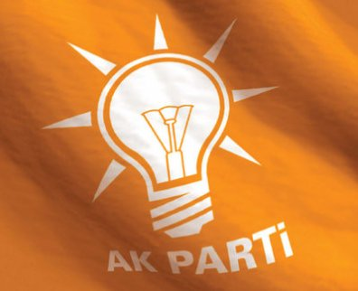
Pres. Recep Tayyip Erdoğan
AKP – Adalet ve Kalkınma Partisi (Justice and Development Party)
“AK” parti (means white or pure)
Elected for the third time in 2011/elected President in 2014
Turkey has average over 5% GDP growth since their first election in 2002
Is Democracy “a train from which you get off once you reach the station”.
More journalists are in jail in Turkey than in China

Slide 6
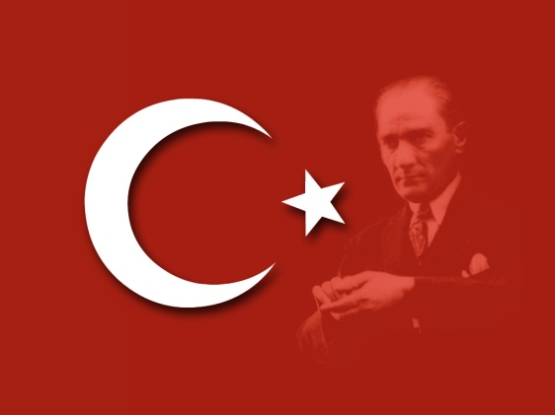
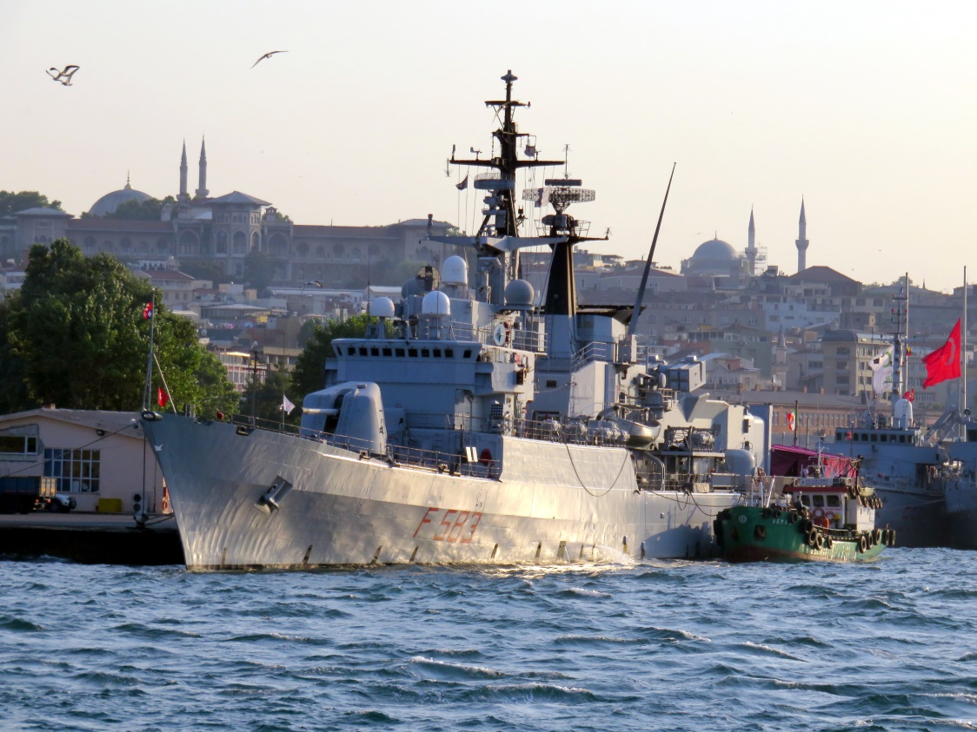
The Turkish Military
Mandatory Military Service
The protector to Attatürk’s Secular constitution
Highly respected in the Turkish State
NATO’s second largest military

Slide 7
The Turkish Military
The Military stepped in 3 & ½ times in the Turkish Republic: 60, 71, 80 & a “postmodern” coup in 97 forcing the Refah govt. to step down

Slide 8
Erdoğan’s Revenge

Slide 9
Erdoğan’s Revenge

Slide 10
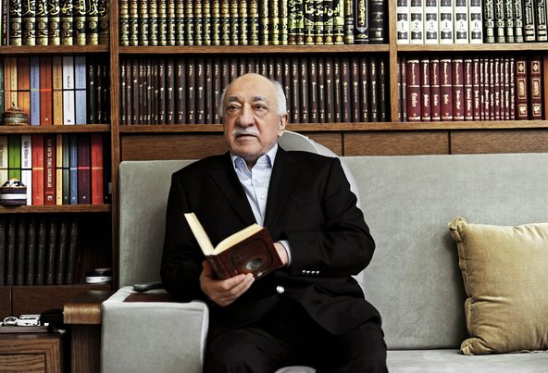
Fetüllah Gülen - Hizmet
Led the Coup from the Poconos?

Slide 11
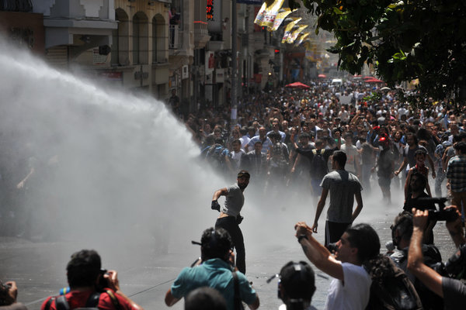
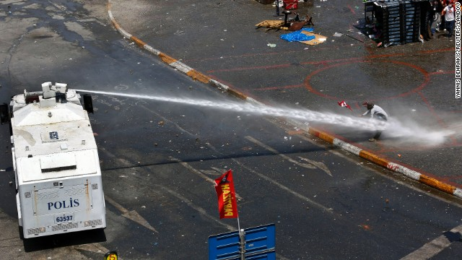
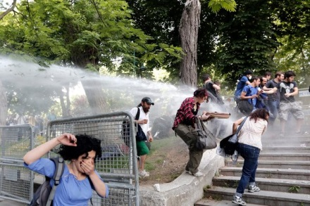
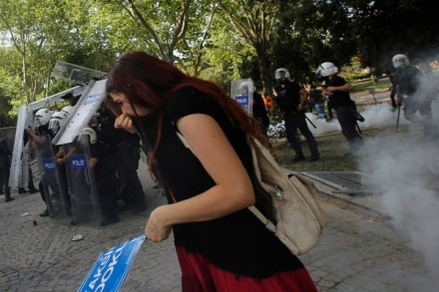
31 May – Due to social media, the crowd expands, followed by the 1st severe police crackdown

Slide 12
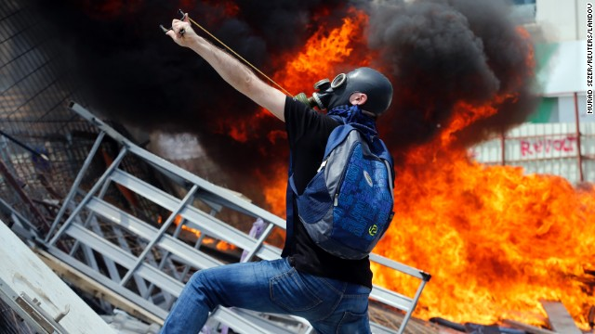
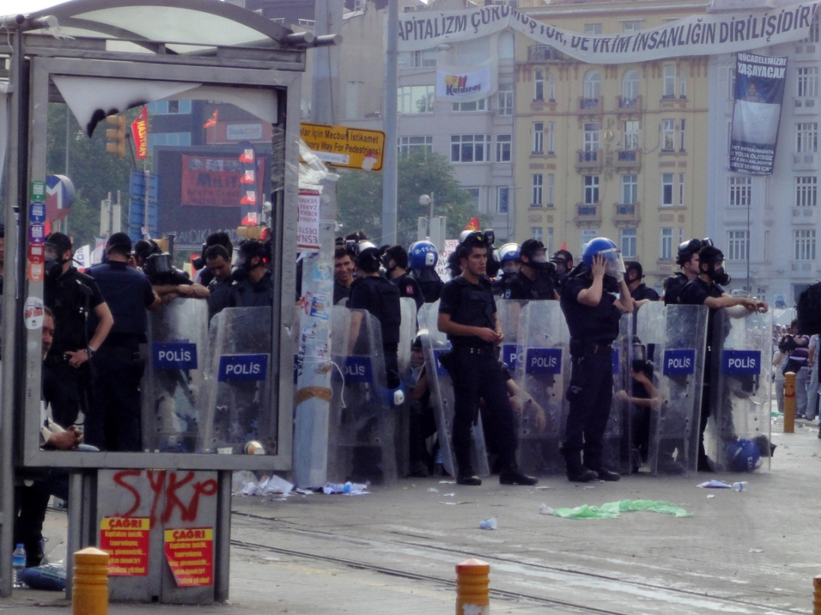
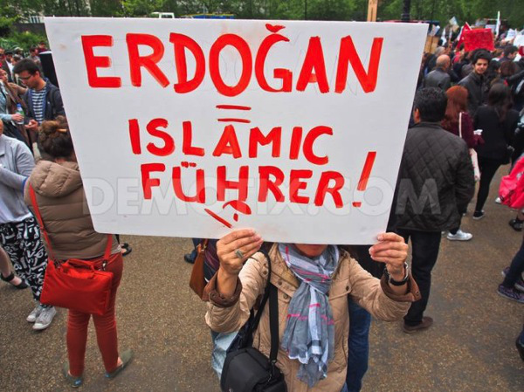
Gezi Park 2013

Slide 13
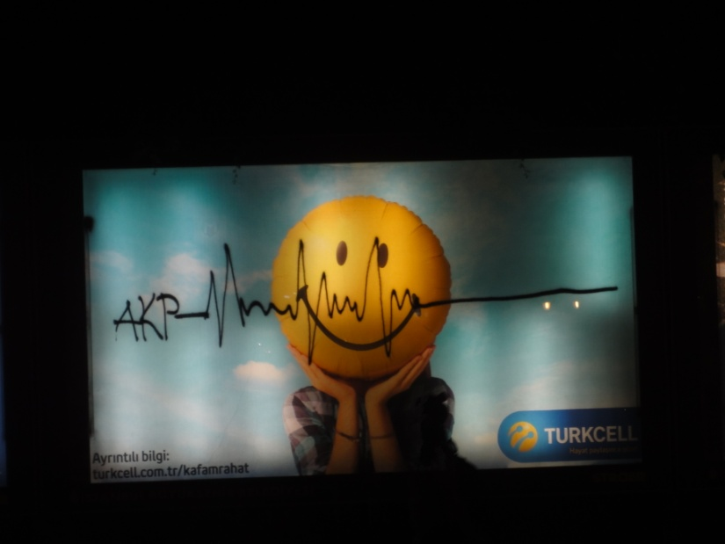
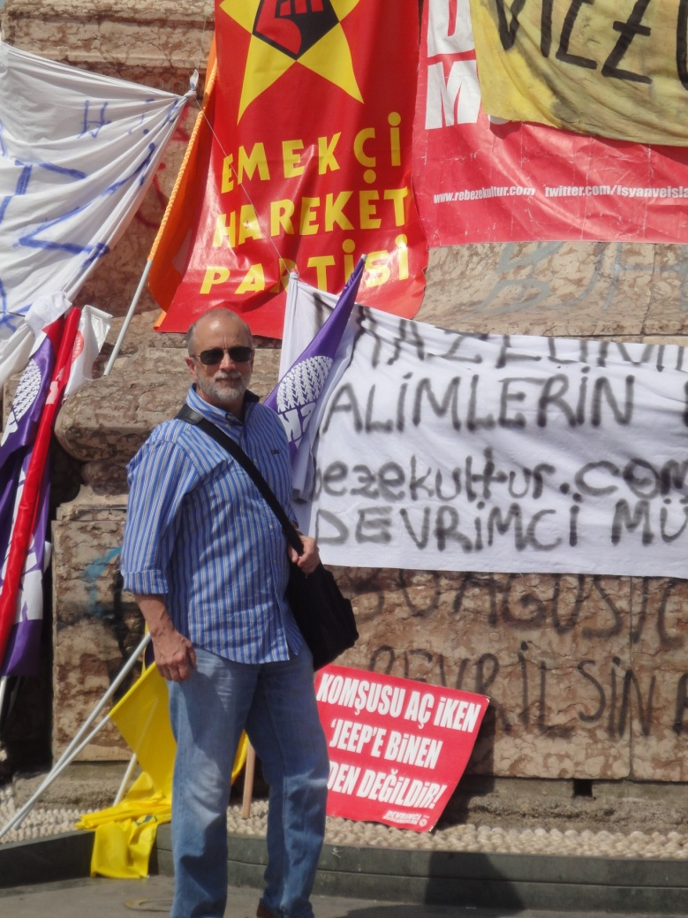
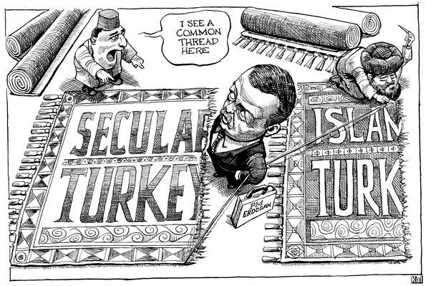
Is It over?

