Slide 1
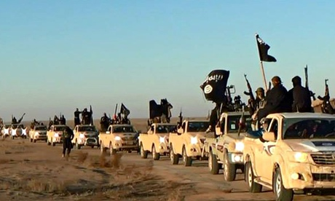
ISIS, ISIL, IS, Da’ish, Daesh or الدولة الإسلامية في العراق والشام‎ al dawla al Islamiya fi al Iraq wal sham?
Not to be confused with “Daes” – to crush underfoot

Slide 2
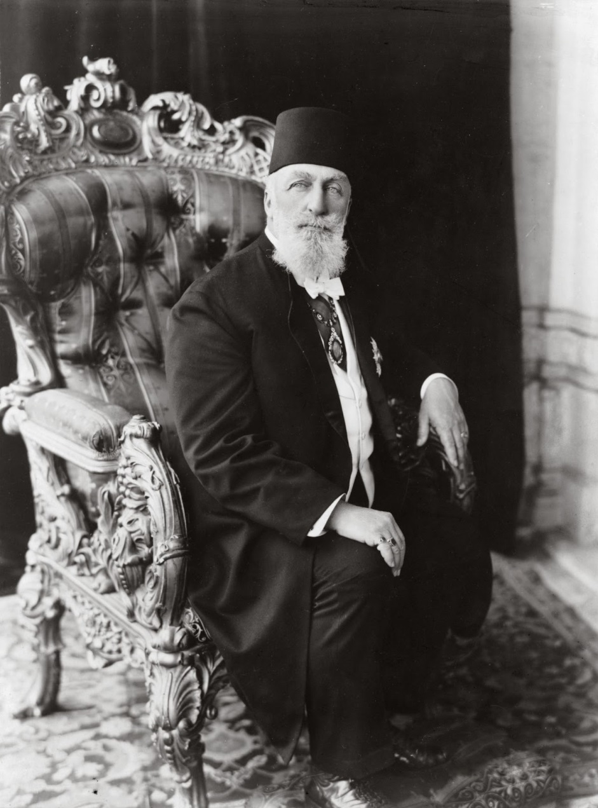
Heir to the Caliph?
Abu Bakr al-Baghdadi
Sultan Abdulmecid

Slide 3
Islamic State of Iraq and al-Sham
Capital – Raqqa
Proto State with an armed force of about 100k Sunni Fighters
End of the Sahwa When Maliki disbanded Sunni Militias
Organized Prison breaks at Abu Ghraib and Mosul for 3000 hard core jihadists
Estimated to have killed 6000 in Syria with 75-95% of all attacks
Allied groups: al Nusra, Ansar Bait al Maqdas, Salafi Front

Slide 4
In Reality the Heir to AQI (al Qaeda in Iraq)
Abu Musab Al-Zarqawi
Jordanian Jihadist radicalized by Imam abu Muhammad al Maqdisi & founded Tawhid wa’l Jihad
1st attack UN HQ in Baghdad
Alienated al Qaeda leadership due to his brutality
Tapped into hostility/ humiliation of disenfranchised Sunni
2006 Anbar Awakening?
Killed by US special forces in a small cinder block farmhouse 40 miles north of Baghdad in 2006

Slide 5
Who makes up ISIS?
Three Factions
Foreign Sunni Volunteers
Former Iraqi Sunni Bathist Army officers
True Ideologues – Abu Bakr al Baghdadi & his apocalyptic version of Islam

Slide 6
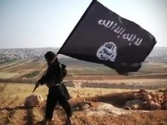
WHY?
Chaos in Iraq and Syria
US invasion in 2003
US Withdrawal
“Hama Rules” in Syria
Failure of al Maliki government in Iraq
Stoking of sectarian tensions by both govts.
Western failure to support “moderate” rebels in Syria
Kurdish desire for independence
RD in the Arab World – US mistake of “overestimating the power of religious ideology and under appreciating the impact of misgovernance.”

Slide 7
How are they funded?
Oil
Stolen Iraqi Dinars
Extortion/Taxation
Selling of Antiquities

Slide 8
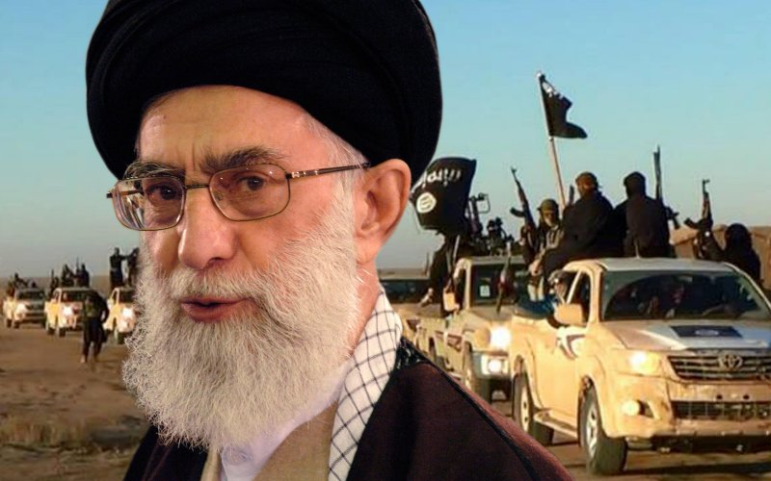
Who are the enemies of ISIS?
US
Russia
Turkey
Iran
Kurds
Yazidi
Barzani
Talabani
PKK
YPG (Syrian People’s Protection Brigades)
Iraqi Army
Syrian Army
Nusra Front
Al Qaeda
Hezbollah
Iraqi Shia Militias
Badr organization
Madi Army (Muktada al Sadr)

Slide 9
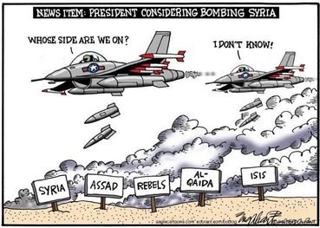
“The enemy of my enemy is my friend”

Slide 10
A war against ISIL

Slide 11
A Syrian Civil War
a
“The enemy of my enemy is my friend”………….Not Likely in Syria

Slide 12
Areas of Kurdish inhabitants
25 Million live in Turkey, Syria, Iraq, Iran and Armenia
The largest nation without a state

Slide 13
Putin’s Intervention
And Pullout?
Goals:
Bringing Russia back to center stage in the global arena
Preventing Regime Change in Syria (particularly by outside powers)
Strengthening Pres. Assad
Maintain base in Syria
Picking off Russian Jihadists on the battlefield

Slide 14
Tactics, Future & Solution
Abu Bakr al Baghdadi’s ex-wife says “he was a good father and not a violent man”.

Slide 15
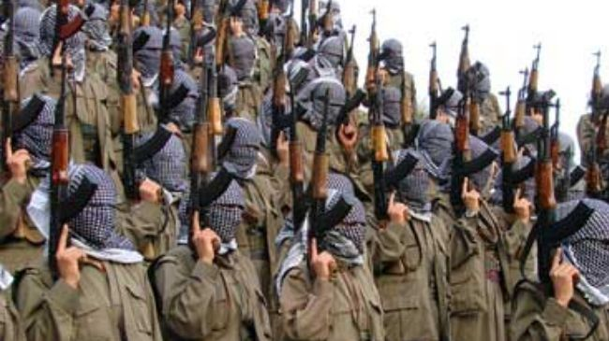
The Kurds, Turkey & ISIL
Attaturk’s 1924 Decree
Sheik Said Rebellion
“Mountain Turks”
1978 PKK (Partia Karkarem Kurdistan
40 K fatalities
Erdogan’s 1991 law change
ISIL impact on the Kurds
YPG
Kobani

Slide 16
The death of Abu Bakr al Baghdadi
Abū Bakr al-Baghdadi al-Qurashi (Arabic: أبو بكر البغدادي‎; born Ibrahim Awad Ibrahim Ali al-Badri al-Samarrai, إبراهيم عواد إبراهيم علي محمد البدري السامرائي‎; 28 July 1971 was killed 1 Nov 2019
Also Killed was ISIS spokesman Abu Hamza al-Quarashi
New Leader Abu Ibrahim al Hashimi al Quarashi

Slide 17
Discussion Questions
Why is ISIL/Daesh important?
Why have they been able to recruit so effectively?
Who are their friends and enemies?
Have they been controlled and are they in decline?
What should the U.S. do now?

Slide 18
Paris 2015 Ankara 2015 Brussels 2016 Istanbul 2017

