Slide 1
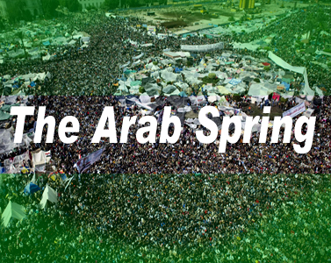
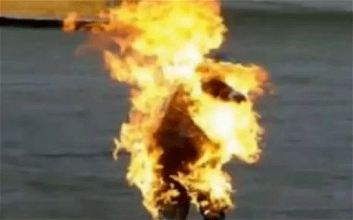
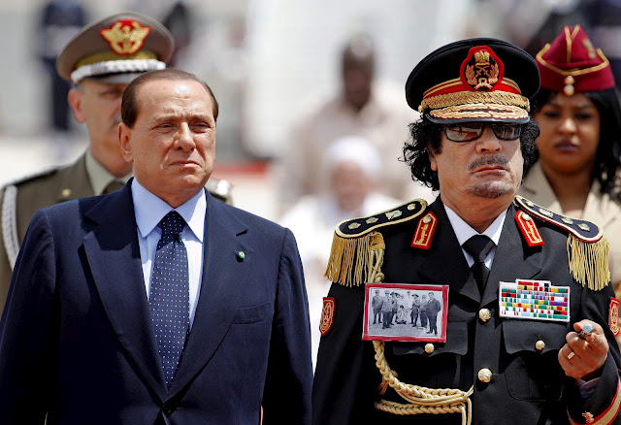
2011
Mohamed Bouazizi Tunisia

Slide 2
Questions?
What comes to mind when you think about the Arab Spring?
Why then?
Why this region?
Is it over and/or was it successful?
What was/is the significance?
What Theory of Revolution best explains these events

Slide 3
Obama’s Cairo Speech
http://www.youtube.com/watch?v=B_889oBKkNU

Slide 4
Geography of the Arab Spring

Slide 5
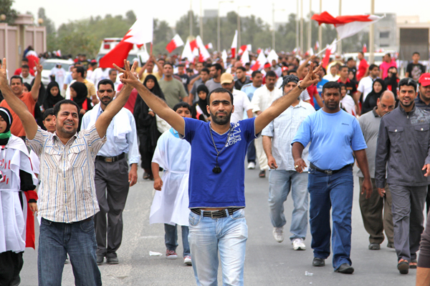
Characteristics
Arab, not Sectarian (in general)
Lower classes, Students, Laborers, Military
Populist
Social Media
Civil Resistance (strikes, protests, and demonstrations)
U.S. supported authoritarian regimes
الشعب يريد اسقاط النظام

Slide 6
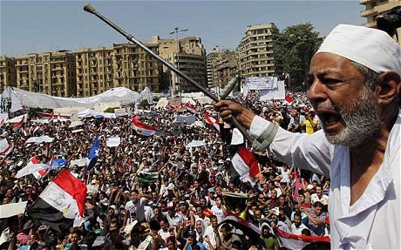
Causes
Democratic deficit: dictatorship & authoritarian regimes
Human rights violations
Government corruption
Economic turmoil
A young, educated, and idle populace

Slide 7
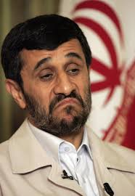
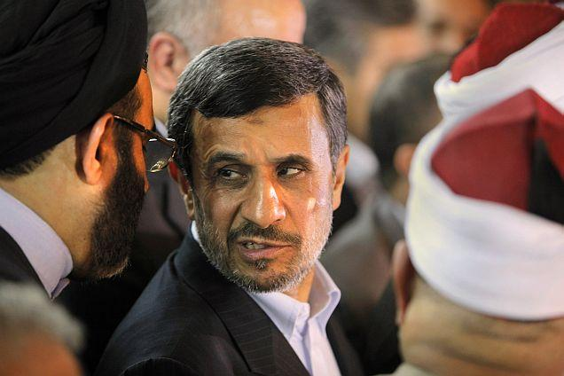
Iran 2009
Protests about the 2009 Iranian Presidential Election
June 13, 2009
Re-election of President President Mahmoud Ahmadinejad
Opposition candidates: Mir-Hossein Mousav, Mehdi Karroubi
Ayatollah Ali Khamenei: “divine assessment”
Ahmadinejad: “completely free” and “passions after a soccer match”

Slide 8
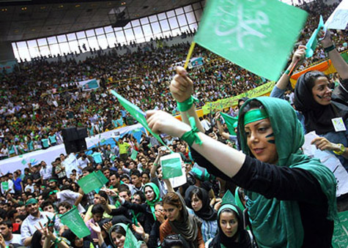
Iran cont’d
Police and Basiji use of force and violence
Iranian government response
Foreign Intervention
Green Revolution: protests in Iran and around the world
Iranian Green Movement: group to protest the election
“Twitter Revolution”

Slide 9
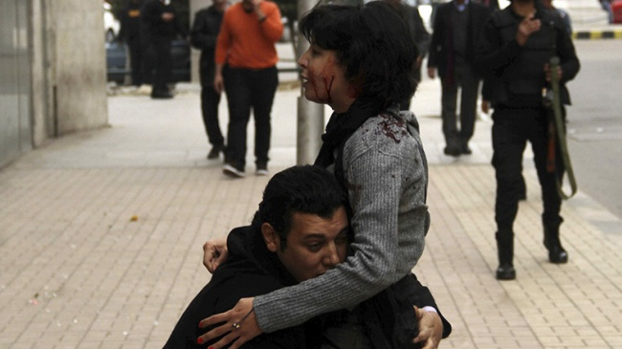
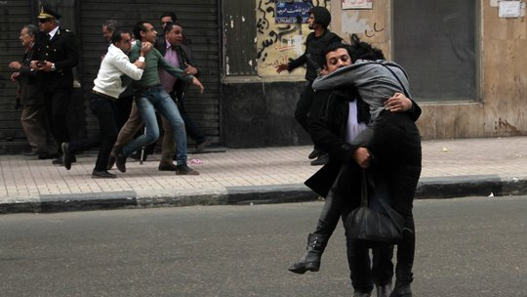
Shaimaa el Sabbagh Cairo 2015

Slide 10
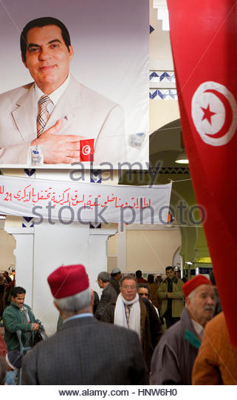
Jasmine Revolution
Mohamed Bouazizi 17 Dec 2010 in Sidi Bouzid

Slide 11
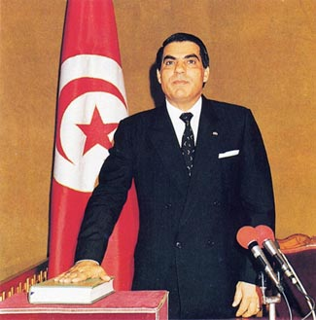
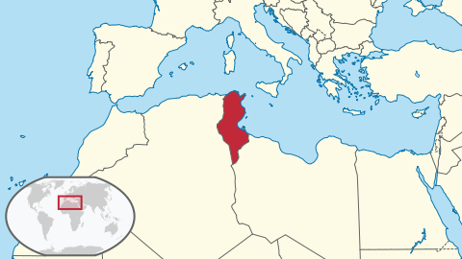
Jasmine Revolution Revolutionary Situation
President Zine al-Abidine Ben Ali – Mukhabarat
Tunisian Economy
Democratic Deficit
Corruption
The Army
International Context

Slide 12
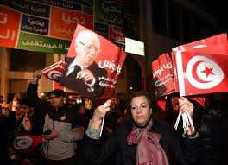
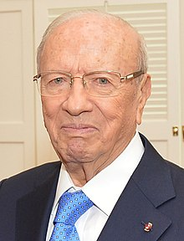
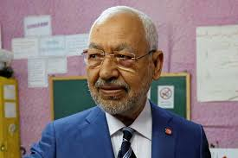
Jasmine Revolution Revolutionary Outcome
Why Democracy?
Interim Government
RCD Party banned
Ennahda/Gannouchi elected
New progressive constitution
Beji Cai Essebsi
Islam and Democracy
Civil Society

Slide 13
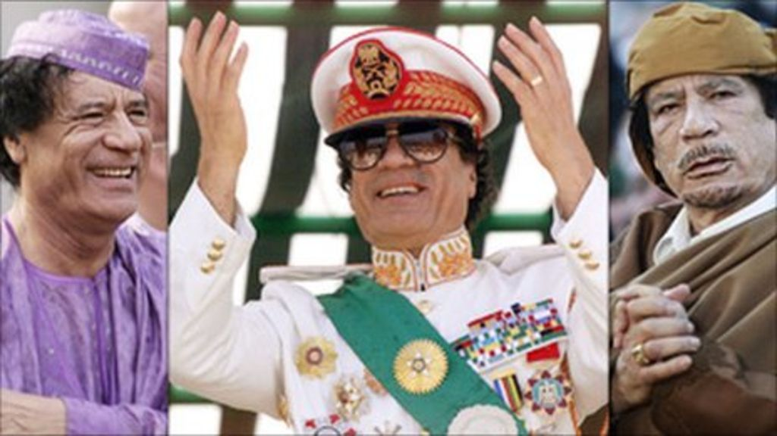
Libya 2011 – The End of el Qadaffi
Feb 11 – Anti Government demonstrations spread to Tripoli & quickly became armed revolt
Mar 11 – UN Security Council authorizes “all necessary measures” to protect the population

Slide 14
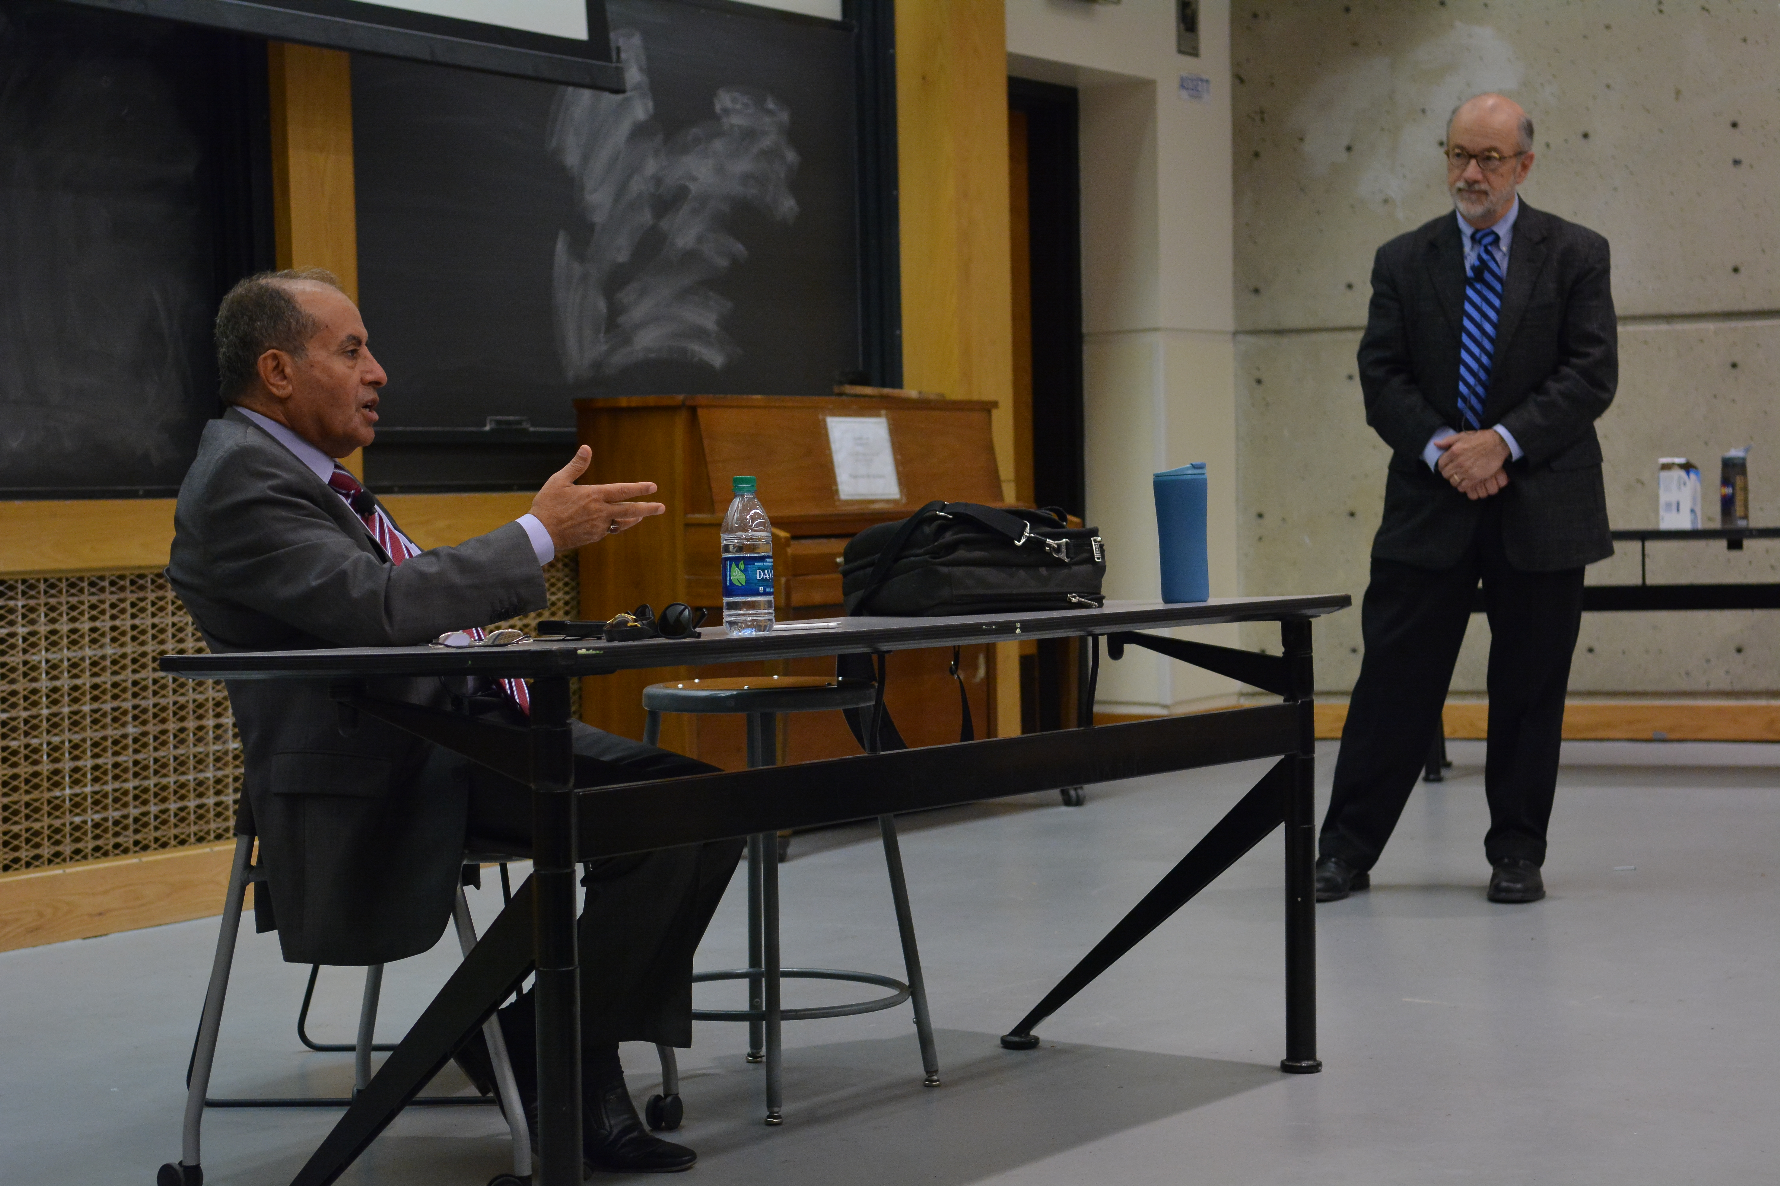
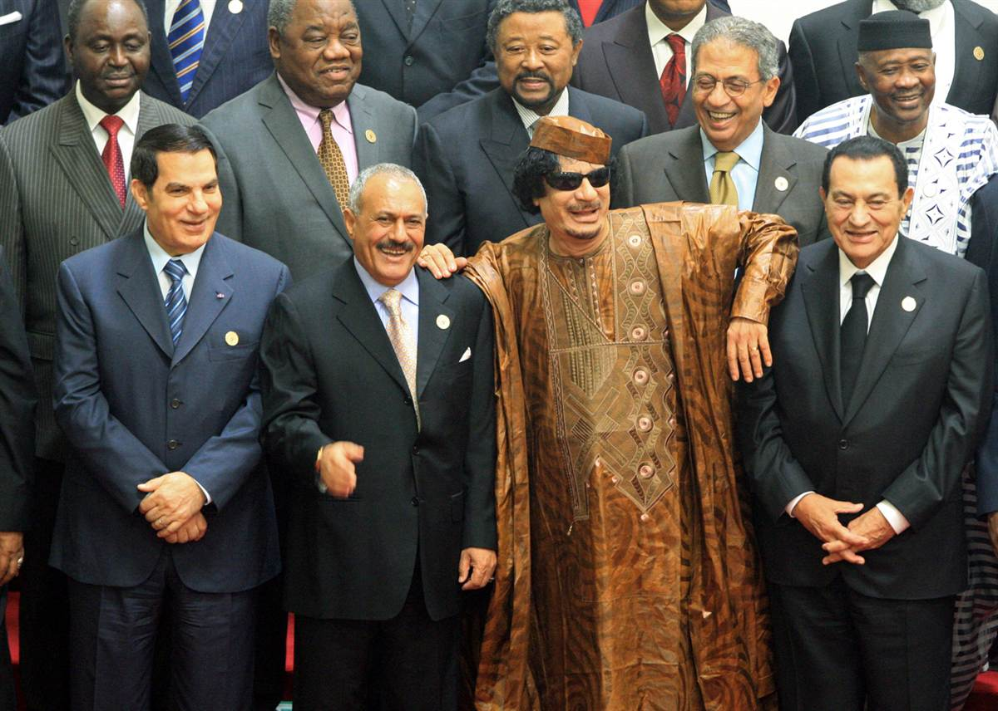
Libya 2011 – The End of el Qadaffi
Mar 11 – NATO Airstrikes support Rebels advancing fm Benghazi
Aug 11 – Tripoli falls after 6 months of brutal fighting particularly in Misrata, 6k dead
Aug 11 - Khadaffi is captured in near his hometown of Surt, where he is beaten and killed, ending 42 yrs of rule
Jul 12 – NTC/Jebril & Elections
Today – Instability over 300 Militias compete for control

Slide 15
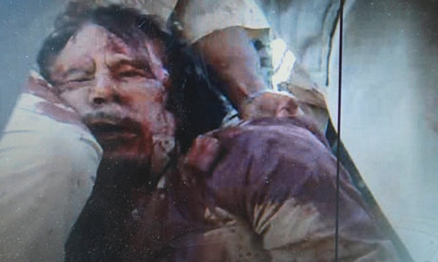
LIBYA – The End of Colonel Qaddafi
UN Resolution 1973 of Mar 2011 hands control to NATO
Who are we helping/arming?
Benghazi
Qaddafi’s Rule
Italian Fascism
Capricious Extravagance
Kin & Clan
Military Disorganization

Slide 16
Timeline: December 2010

Slide 17
January 2011

Slide 18
January cont’d

Slide 19
January cont’d

Slide 20
February 2011

Slide 21
February cont’d

Slide 22
March and May 2011

Slide 23
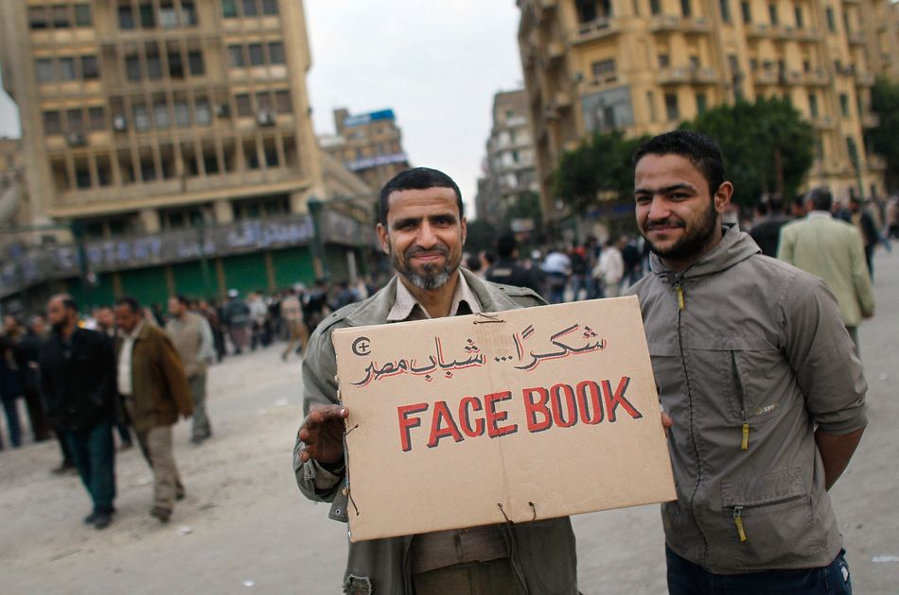
Social Media
What is social media?
What role did social media play?
Could this have happened without social media?
1990s, 1980s, 1970s, etc.?
1919?
Government control
Iran and China’s experience with control

Slide 24
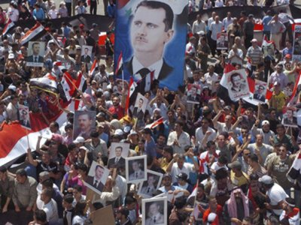
Arab Spring - Syria

Slide 25
Arab Spring – Syria
The same or unique?
Sectarian: Nasayris or Alawites
Are they Muslim?
The Prophet Ali/Savior Ali

Slide 26
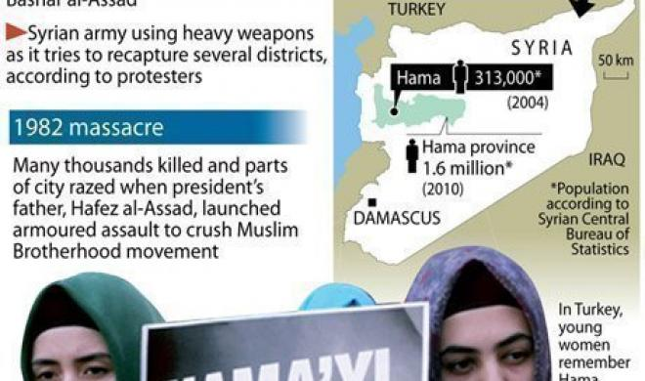
Arab Spring - Syria
History with Israel
Hassef al Assad, ruled 1970-2000
Attempted assassination by the Muslim Brotherhood 1980
Palmyra prison
“Hama Rules” Feb 1982

Slide 27
Arab Spring - Syria
History with U.S.
Bashir al Assad
2008 Hariri assassination
Petraeus, AQI and Syria & Abu Ghadiya
Abu Kamal Raid
Blowback

Slide 28
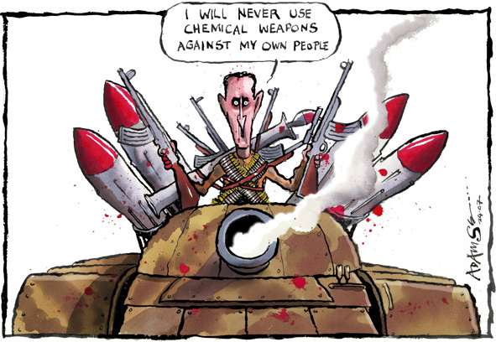
Syria - WMD

Slide 29
Syria - WMD

Slide 30
Obama & Syria
Missed Opportunities with SNC, NCC & OSOS
Chemical Weapons
Arming the Opposition
Refugees
Courting Assad
Condemning Assad
Putin?

Slide 31
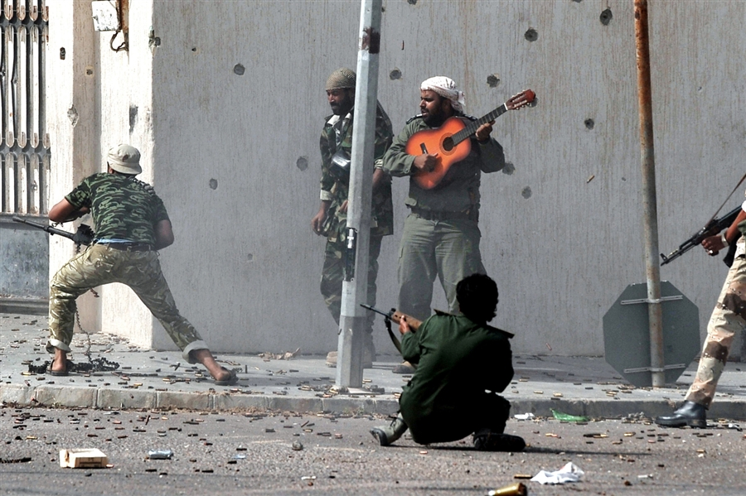
U.S. Responses
U.S. supported the Tunisian and Egyptian people Sec. of State Hilary Clinton pledged $150 million in emergency aid to Egypt
U.S. Export-Import Bank $80 billion in letters of credit to Egypt
USAID $50,000 to Tunisia for disaster relief
UN Security Council drafted a resolution calling on Assad to step-down or face “harsher” measures in 15 days
The US used military force in Libya, but has refused to so in Syria

Slide 32
Arab Spring - U.S. Responses
Should the U.S. support democratic elections in historically autocratic states?
Should the U.S. support autocratic leaders in order to maintain stability?
Should the U.S. support the protestors by offering moral support against the use of violence by the regimes?
Should the U.S. arm the opposition to autocratic leaders?
Encourage Arab leaders to cancel emergency laws
Encourage control of the security forces to end corruption w/little violence Encourage the development of civic advocacy
Economic aid
Trade

Slide 33
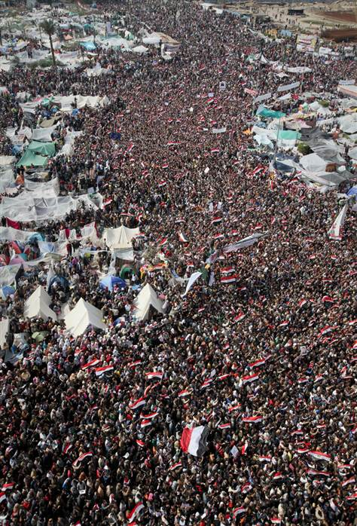
Impact of the Arab Spring
Do you recognize the impact of these events globally?
Europe
Central Asia
East Asia
Africa
America
Roles of the Western powers?
Economic effects?

Slide 34
Was/Is it a Revolution?
American & French Revolution
Radical overthrow of government
Republicanism
Class struggle to change the nature of politics and society
Occurred in a single geographical area
Development of nationalism
Defronzo
Arab Spring
A wave of protests, strikes and demonstrations
Some overthrown of governments
Class struggle
Minority groups
Regional influence
New identity?
Arab Nationalist?

Slide 35
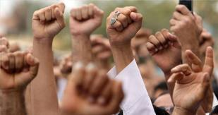
Questions?
Why now?
Why this region?
Is it over and/or was it successful?
How does this affect you?
What was/is the significance?

